Slide 1

Infosys SpringBoard Virtual Internship 7.0
Internship Completion Report
Batch 1 Group 1
Team : A
Team Members: Akshay Jaiswal,Srinidhi,Darsh Dwivedi,Deepan S,Harini T,Hemanth M
Mentor: Mrs. Nithayasri S J
Internship Duration: 8 weeks
Year: 2026
Project Title:
“Advanced Threat Incident Analytics and Security Visualisation Framework”

Slide 2




Objective
Purpose of the Project
Why Threat Analytics Matters
Analyze real-world cyberattack data to detect patterns of malicious network activity.
Enables early detection of intrusions and reduces response time to security incidents.
Importance of Visualization
Expected Outcome
Transforms raw security logs into clear, actionable dashboards for decision-makers.
An interactive Power BI dashboard revealing key threat trends and attack insights.

Slide 3




Introduction
Cybersecurity Overview
Network Intrusion Detection
Protecting systems, networks and data from digital attacks and unauthorized access.
Monitoring network traffic to identify suspicious or malicious activity in real time.
Why Organizations Need Threat Analytics
Importance of Power BI
Rising attack volumes demand data-driven detection instead of manual monitoring.
Turns large security datasets into interactive visual dashboards for quick insights.

Slide 4






Workflow Diagram
Raw Dataset
(Kaggle)
Data
Collection
Data
Loading
Data
Understanding
Data
Preprocessing
Data Visualization
(Power BI)
Threat Analytics
Dashboard
Insights &
Conclusion

Slide 5

Problem Understanding
Increase in Cyber Attacks
Organizations face a rapidly growing volume and variety of cyber threats every year.
Difficulty Identifying Malicious Traffic
Distinguishing genuine traffic from malicious activity is complex without proper tools.
Importance of Preprocessing
Raw security data contains noise, gaps and inconsistencies that must be cleaned first.
Need for Visualization
Visual dashboards make it far easier to spot attack trends than raw tabular logs.

Slide 6






Data Collection & Understanding
Dataset Overview
Key Features
Dataset Name
Cybersecurity Threat
Detection Logs
Timestamp — Date/time of the network event
Source & Destination IP — Traffic origin and target
Number of Rows
600,000
Protocol — Communication protocol used
Number of Columns
10
Threat_label — Size and category of packet
Dataset Type
Raw, unprocessed data
Log_type — Classification of network traffic
Data Types
Numerical, categorical
and timestamp
Action — Nature of the action

Slide 7



Data Connection
1
Download the dataset from Kaggle
2
Import the dataset into Power BI
3
Open Power Query Editor
4
Verify all columns are loaded correctly
5
Check and confirm data types
6
Dataset ready for preprocessing

Slide 8






Data Preprocessing
A 12-step preprocessing pipeline transforms raw logs into analysis-ready data
1. Data Collection
2. Data Loading
3. Data Inspection
4. Handling Missing Values
5. Removing Duplicates
6. Handling Outliers
7. Data Cleaning
8. Encoding Categorical Features
9. Feature Scaling
10. Feature Selection
11. Data Splitting (Train/Test)
12. Saving Preprocessed Dataset

Slide 9
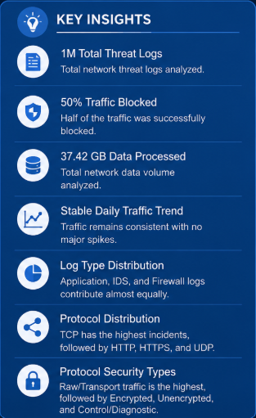
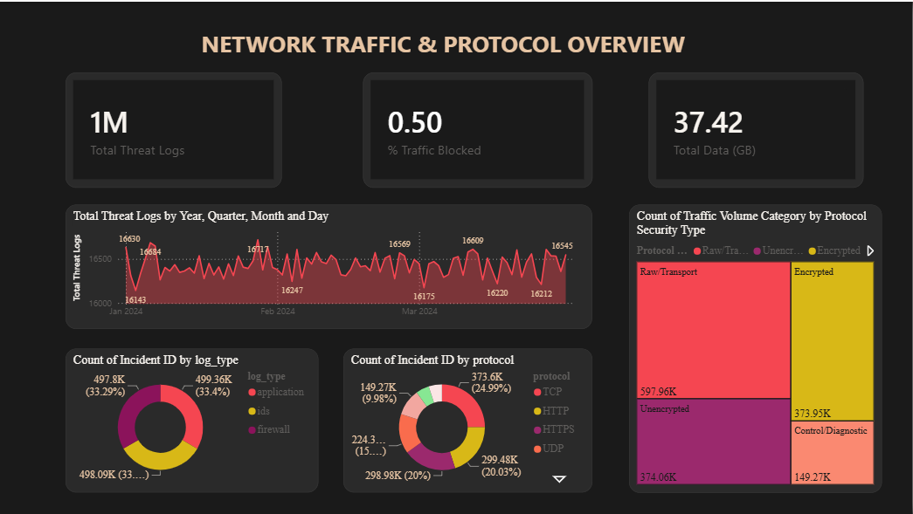
DATA VISUALISATION • DASHBOARD 1 OF 7
Network Traffic & Protocol Overview

Slide 10
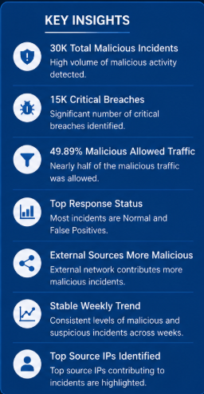
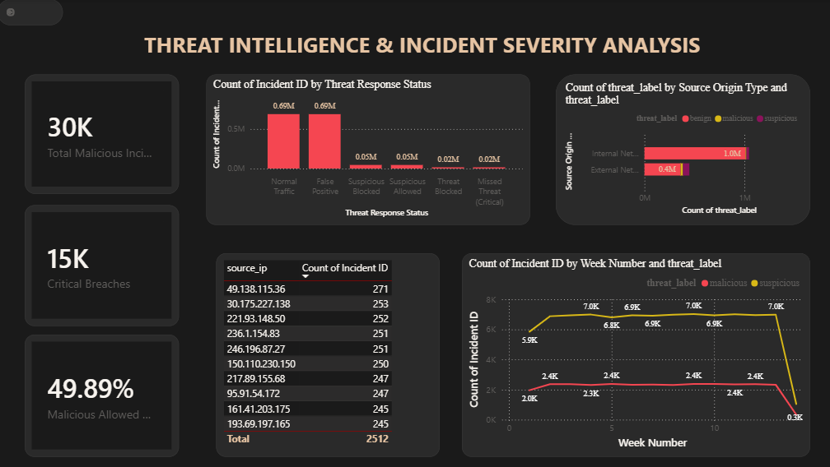
DATA VISUALISATION • DASHBOARD 2 OF 7
Threat Intelligence & Incident Severity

Slide 11
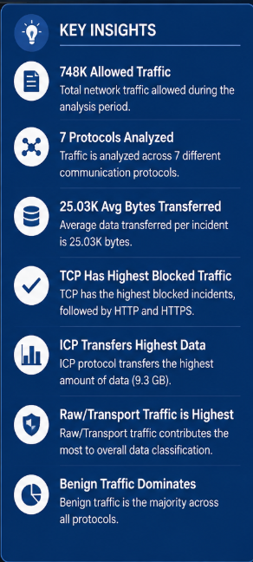
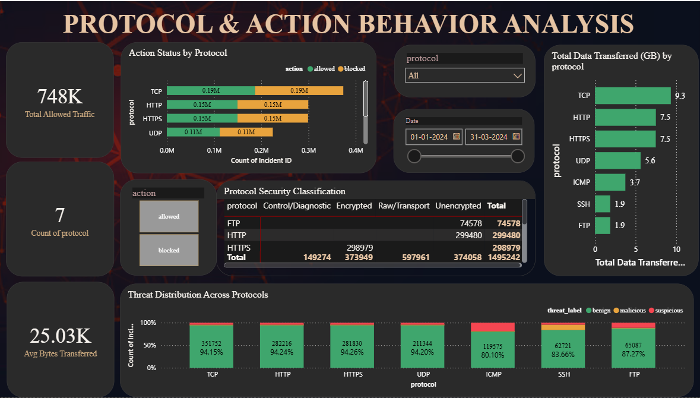
DATA VISUALISATION • DASHBOARD 3 OF 7
Protocol & Action Behaviour Analysis

Slide 12
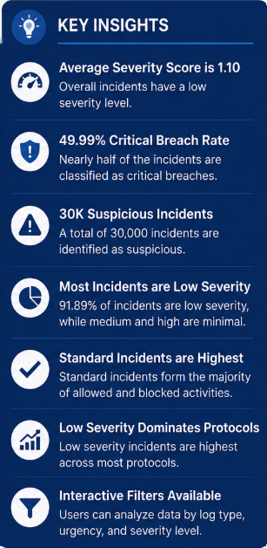
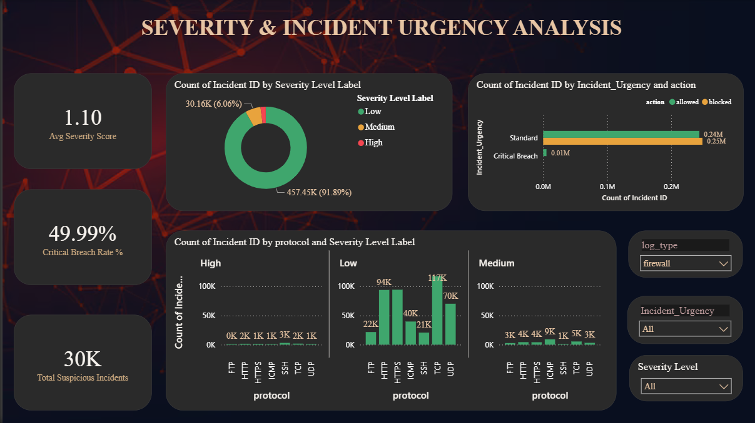
DATA VISUALISATION • DASHBOARD 4 OF 7
Severity & Incident Urgency Analysis

Slide 13
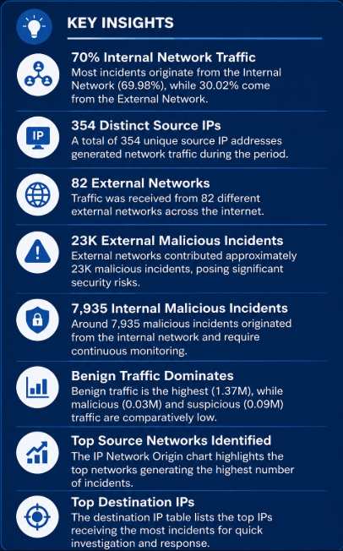
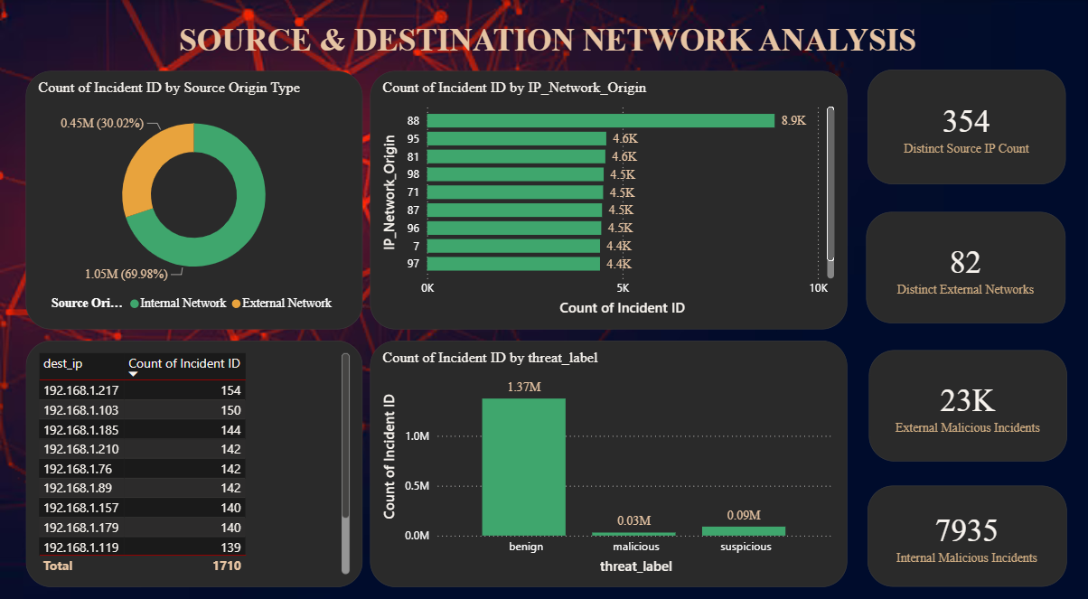
DATA VISUALISATION • DASHBOARD 5 OF 7
Source & Destination Network Analysis

Slide 14
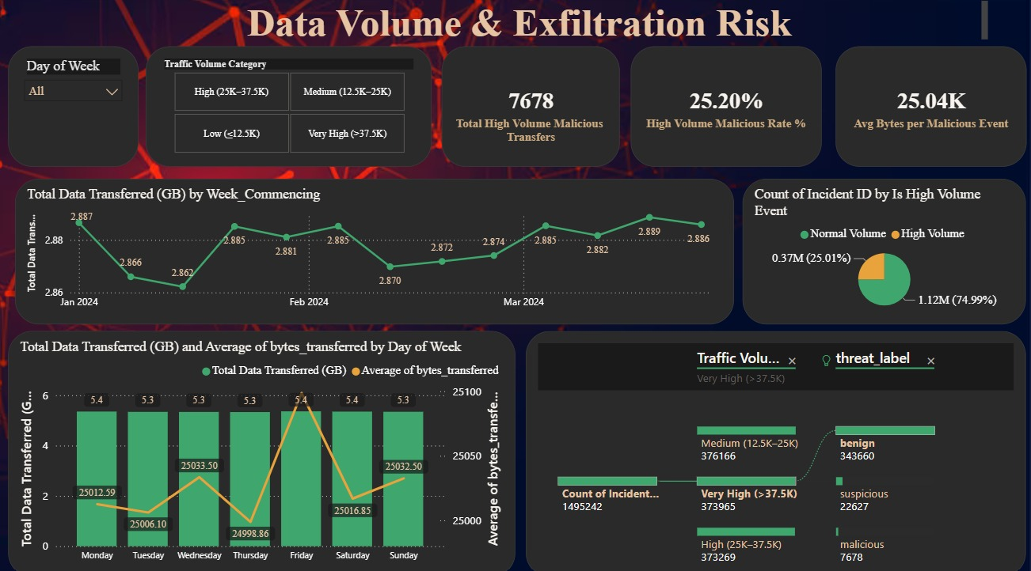
DATA VISUALISATION • DASHBOARD 6 OF 7
Data Volume & Exfiltration Risk
KEY INSIGHTS
7,678 High-Volume Transfers
Malicious transfers in the high traffic band.
25.20% Malicious Rate
Share of high-volume traffic that is malicious.
25.04K Avg Bytes / Event
Average bytes per malicious event.
Stable Weekly Volume
Transfers stay steady near 2.86-2.89 GB.
Mostly Benign Traffic
Malicious traffic is a small minority overall.

Slide 15
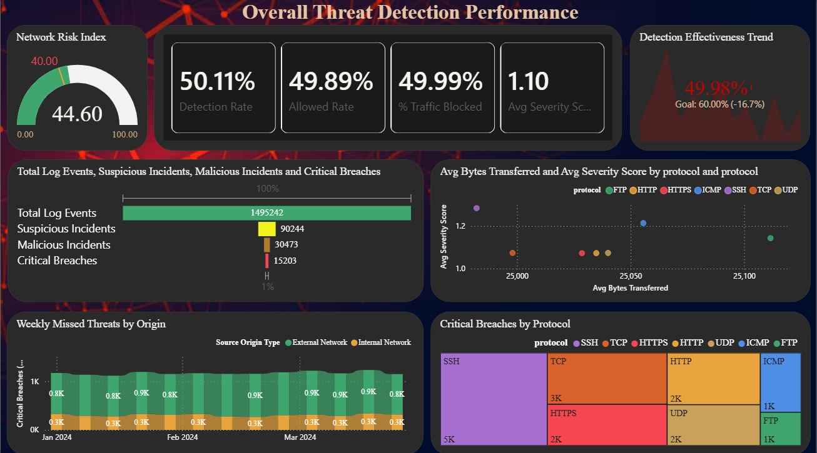



DATA VISUALISATION • DASHBOARD 7 OF 7
Overall Threat Detection Performance
KEY INSIGHTS
44.60 Network Risk Index
Above the 40 threshold — elevated risk level.
50.11% Detection Rate
Just over half of all traffic is detected.
49.99% Traffic Blocked
Nearly half of all traffic is actively blocked.
1.49M Log Events
Total events, incl. 15,203 critical breaches.
SSH Leads Breaches
SSH has the highest share of critical breaches.

Slide 16
Conclusion
Successfully collected the raw cybersecurity attacks dataset from Kaggle
Understood the dataset structure, features and target column
Connected and verified the dataset within Power BI
Built a complete 12-step preprocessing pipeline for the data
Delivered a 7-page interactive threat analytics dashboard suite

Slide 17
Thank You

